Slide 1


Slide 2
“ARTIFICIAL INTELLIGENCE”
Course code:418
Course title : Artificial intelligence laboratory
PROJECT ON:
Image processing in face detection used open cv

Slide 3
TEAM MEMBER:
Md.Shawon Hossain
Id:153402351
Md.Faisal Ahmed
Id:152392326
Md.Abu bakar siddik
Id:153402348
Department of CSE

Slide 4
CONTENTS:
Definition
Introduction
Motivation
Features
Flow Chart diagram
Code
Result
Future scope
Implementation image

Slide 5
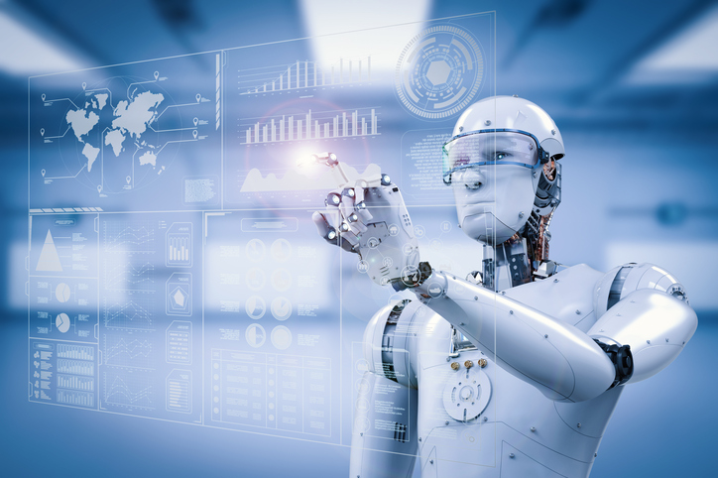
DEFINITION:
Artificial intelligence(AI) is the intelligence of machines and the branch of computer science that aims to create it.

Slide 6
INTRODUCTION:
The following document is a report on the mini project for Robotic visual perception and autonomy. It involved building a system for face detection using several classifiers available in the open computer vision library (OpenCV).

Slide 7

MOTIVATION:
To identify a human face from an image is the main purpose
To study Open CV and implement it in this project.
To understand how face detection method works.

Slide 8
FEATURES:
It can detect all the faces from an image.
It is easy to use.
It can work on low configured computer.
It does not use too much disk space.
Its requirement is easy to get and all software is free in online.

Slide 9
FLOW CHART DIAGRAM:

Slide 10
CODE:
import cv2
import numpy as np
img = cv2.imread('1.jpg')
face_csc = cv2.CascadeClassifier('haarcascade_frontalface_default.xml')
gray = cv2.cvtColor(img,cv2.COLOR_BGR2GRAY)
faces = face_csc.detectMultiScale(gray,1.1,4)
for(x,y,w,h) in faces:
cv2.rectangle(img,(x,y),(x+w,y+h),(0,255,0),3)
cv2.imshow('img',img)
cv2.waitKey(0)

Slide 11
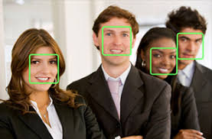
RESULT:
Our project was able to detect the faces from any images successfully.

Slide 12
FUTURE SCOPE:
We will add image recognition to our next update.
We will make a device with camera which will able to detect and recognize the person.

Slide 13
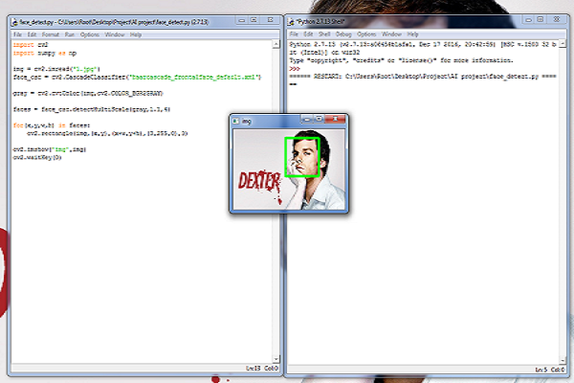
IMPLEMENTATION IMAGE:

Slide 14


